Slide 1
KOD8 Sandbox
NCIA-Compliant Multi-Layer Crypto Engine

Slide 2

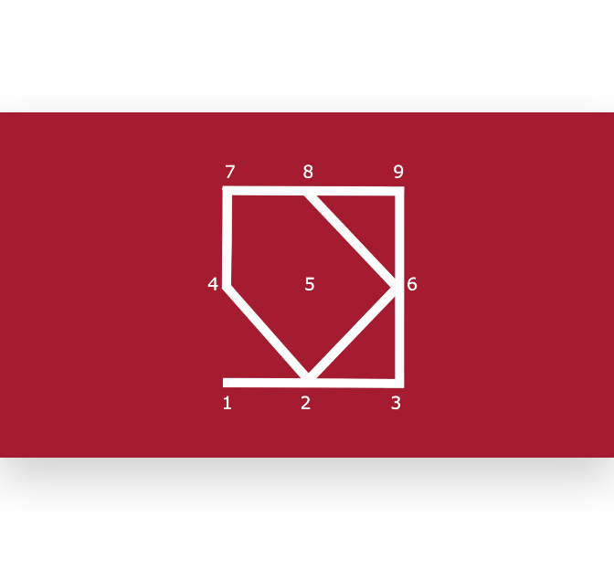
Topological Execution
Hardware trace preserved. Cryptographic primitives upgraded to NATO baseline.

Slide 3


Vulnerabilities Remediated
S-Box Collapse
Static IV Reuse
Frequency Attacks
HKDF guarantees 256-bit entropy.
Dynamic 96-bit random nonces.
AES-GCM prevents statistical recovery.

Slide 4
Pipeline Execution: Preparation
8
6
2
4
HKDF Expansion
Zlib Compression
ML-KEM Wrap
HMAC Signature
Session key derivation.
Eliminates plaintext predictability.
Post-quantum header allocation.
Cryptographic plaintext authentication.

Slide 5
Pipeline Execution: Encryption
7
9
3
1
AES-256-GCM
Uniform Framing
SHA-512 Hash
Terminal Reverse
Authenticated bulk encryption.
Standardized block chunking.
Outer payload integrity validation.
Base64 ASCII armoring.

Slide 6
CL9 Split-Key Provisioning
Hardware Token
Host Token
Volume A: 50MB FAT32 partition.
Enclave: Secure local directory.
Entropy: 64 random bytes.
Derivation: Master key via HKDF.
Exposure: Useless without host.
Result: Zero-cloud hardware unlock.

Slide 7
256-bit
Cryptographically secure AES-GCM target capability.

Slide 8
Deployment Ready
Certified for facility operations.

